Slide 1
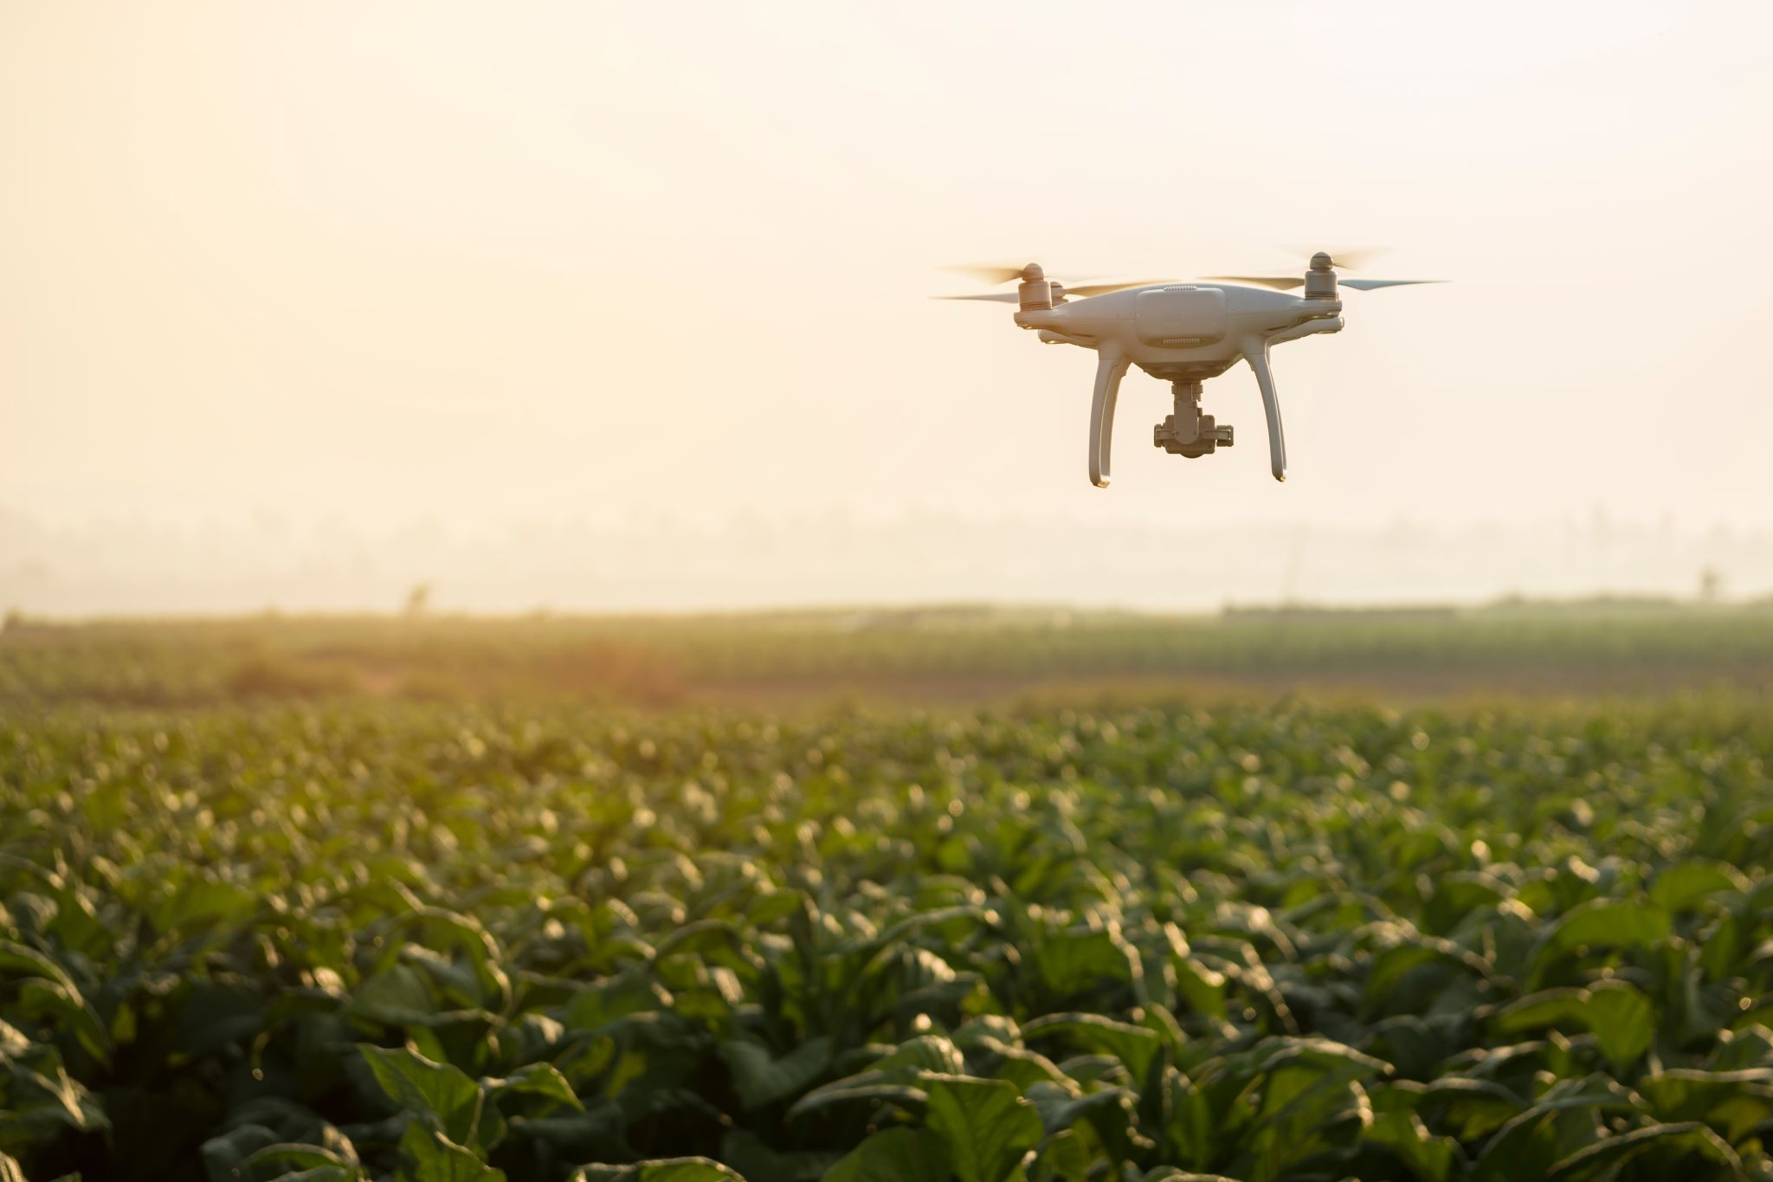
Solution of farmers problems using sensors

Slide 2
Introduction
Welcome to our presentation on the exciting fusion of cutting-edge sensor technologies with traditional agriculture practices. In a world where technology is advancing at lightning speed, it's crucial that the agricultural sector keeps pace.
Farmers face a multitude of challenges, from unpredictable weather patterns to dwindling resources. Our project aims to confront these obstacles head-on by providing farmers with real-time data on weather conditions and soil moisture levels.

Slide 3
Background and Problem
Over time, farming has evolved significantly. From relying solely on manual labor to the introduction of machinery like tractors during the industrial revolution, agriculture has undergone remarkable changes. However, despite these advancements, many small farmers continue to employ traditional farming methods due to the high costs and complexity associated with modern machinery.
For small farmers, the challenge lies not only in ensuring a successful harvest but also in navigating the uncertainties brought about by climate change. Extreme weather events, such as droughts or floods, can have devastating effects on crop yields and the livelihoods of these farmers, exacerbating their financial struggles.

Slide 4
Solution
Our solution employs a combination of soil moisture sensors and LM35 temperature sensors, seamlessly integrated into a unified system. This integration provides farmers with real-time data on weather conditions and soil moisture levels, offering valuable insights into environmental factors crucial for optimizing agricultural productivity.
By utilizing soil moisture sensors, farmers can monitor soil moistureccontent continuously, enabling them to make informed decisions about irrigation schedules to prevent water stress and promote healthy plant growth. Additionally, LM35 temperature sensors accurately measure ambient temperature levels, allowing farmers to adjust farming practices based on temperature fluctuations, such as crop selection, planting times, and pest management strategies. This holistic approach empowers farmers to optimize their agricultural practices with precision, ultimately leading to improved yields and sustainability in agriculture.

Slide 5
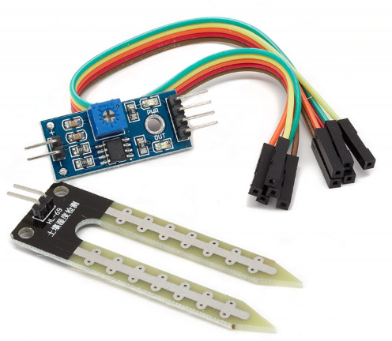
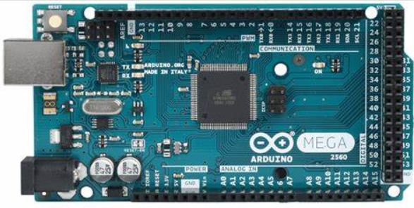
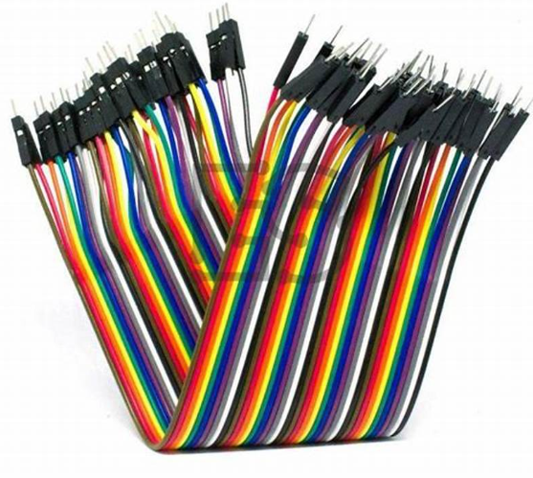
Know the Device
(b)
(a) Connecting WIres
(b) YL-69 (Soil Moisture Sensor)
(c)Arduino Mega 2560
(c)
(a)

Slide 6
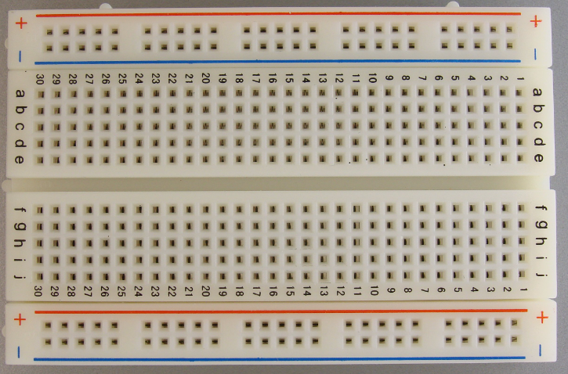
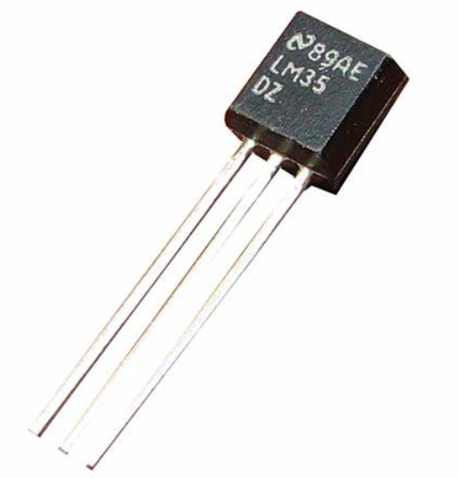
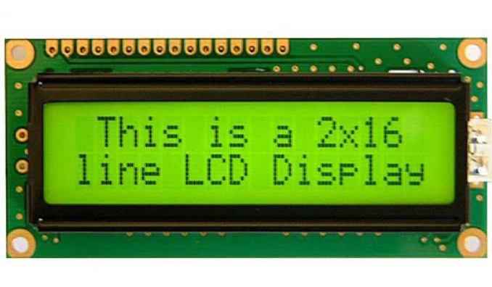
Know the Device
(b)
(a) LM-35 (Temperature Sensor)
(b) Breadboard
(c) LCD Display JHD2162A
(a)
(c)

Slide 7
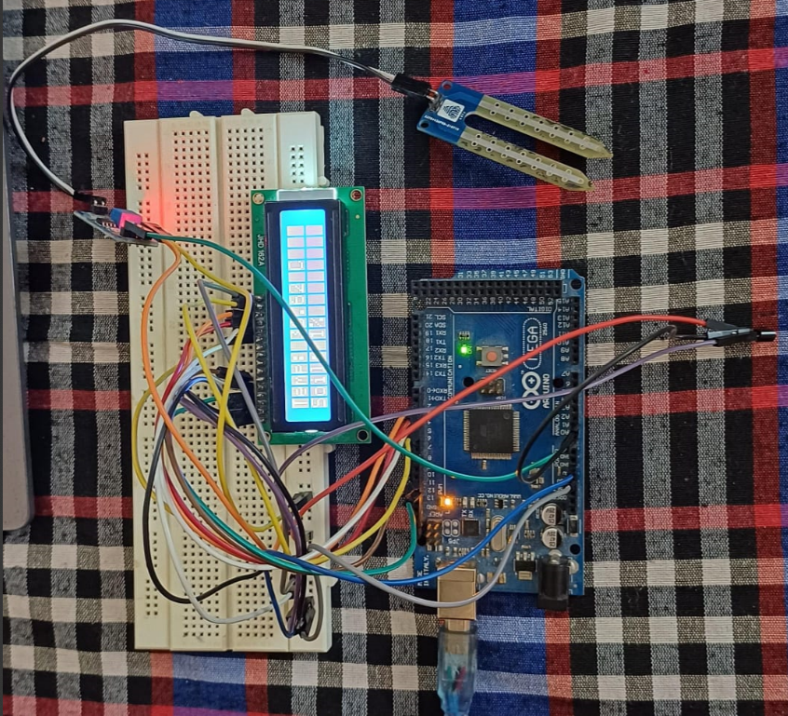
Project Image:

Slide 8
Methodology
Problem Identification: Identified the need for real-time monitoring of temperature and soil moisture levels in agriculture to address challenges faced by farmers.
Component Selection: Selected LM35 temperature sensor and YL-69 soil moisture sensor for their accuracy, reliability, and compatibility with Arduino platform.
Circuit Design: Designed a circuit layout including connections between sensors after many failures, Arduino board, and Liquid Crystal Display (LCD). Ensured proper wiring and component compatibility.
Programming: Wrote Arduino code to read data from sensors, convert analog readings into temperature and moisture percentage values, and display data on LCD screen.

Slide 9
Methodology
Testing and Calibration: Tested the system to verify accuracy of temperature and moisture readings. Calibrated sensors if necessary for improved accuracy.
Integration: Integrated all components into a cohesive system, ensuring correct connections and functionality. Verified that sensors were properly interfaced with Arduino and LCD displayed accurate readings.
Documentation: Documented the entire project including circuit diagrams, code explanations, and testing procedures. Ensured clear instructions for replication and troubleshooting.

Slide 10
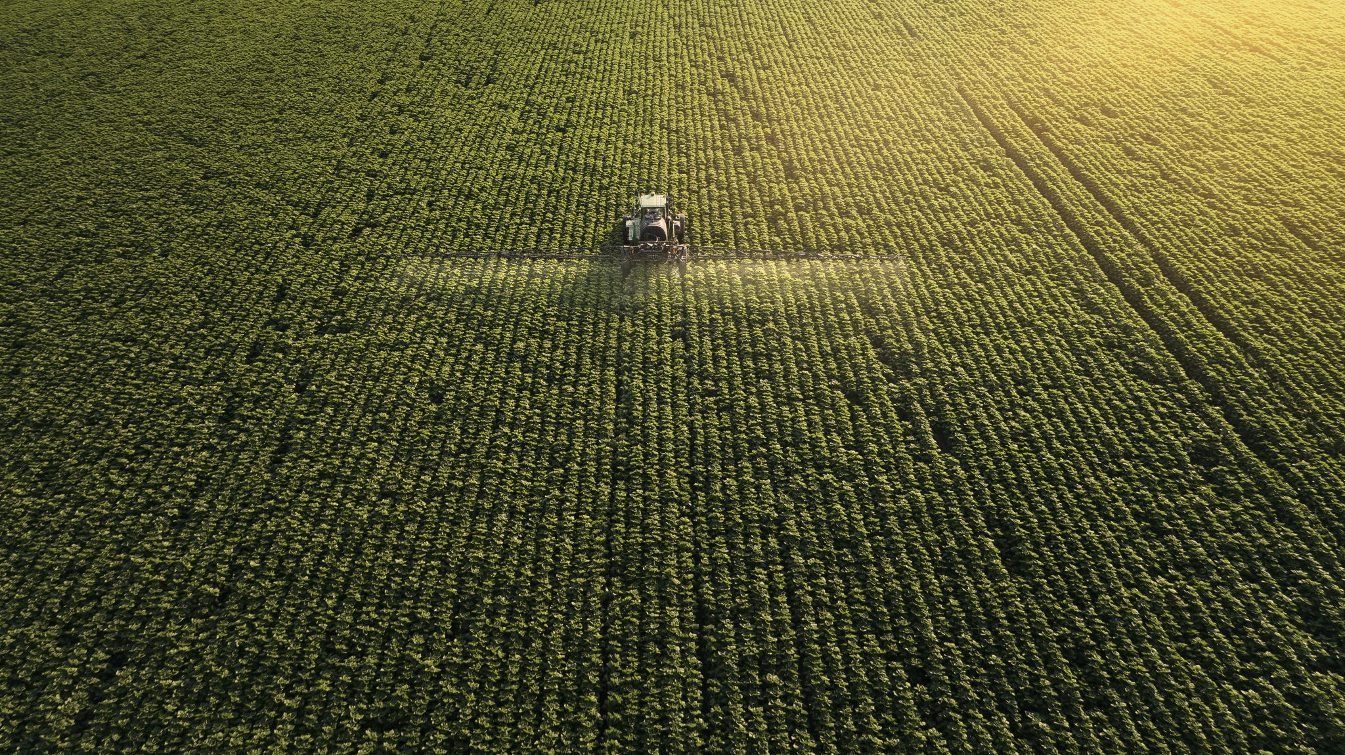
Application and Future Development
Automation: Integration with actuators enables automated tasks like irrigation and pest control, reducing labor and increasing efficiency.
Smart Farming: Advanced analytics offer predictive insights for resource optimization and risk mitigation, enhancing sustainability.
Expanded Sensor Capabilities: Future developments may include monitoring air quality and crop health for comprehensive farm management.
Remote Monitoring: Enable farm management from anywhere, providing flexibility and accessibility for farmers.
Collaboration: Partnering with stakeholders drives scalability and innovation, ensuring our solution meets evolving agricultural needs.

Slide 11
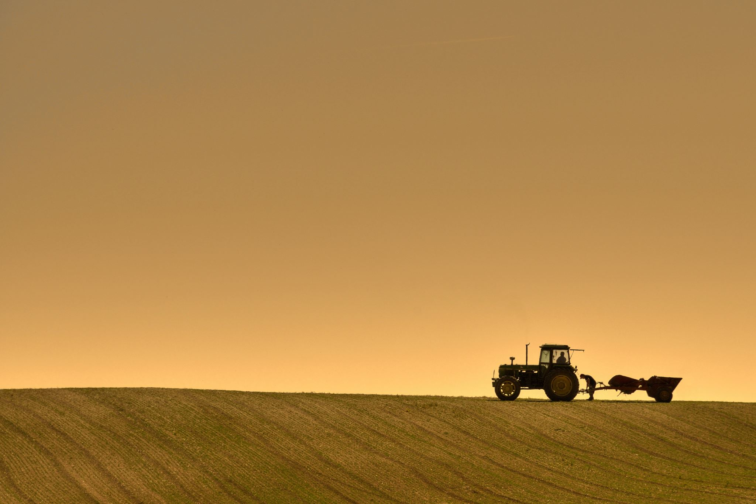
Conclusion
In wrapping up our project, it's clear we've embarked on something special. By combining soil moisture sensors and temperature sensors, we've given farmers a powerful tool. It's not just data—it's the ability to adapt and succeed.
Looking ahead, there's so much potential. From making farming easier with automation to using smart technology for better decisions, our project has opened doors to a brighter future for agriculture.
But let's not forget why we started. Behind every sensor and line of code is a desire to help farmers. Our project isn't just about technology; it's about making a difference in the lives of those who work the land.

Slide 12
Refrences
https://docs.arduino.cc/resources/datasheets/A000067-datasheet.pdf
https://youtube.com/playlist?list=PLV3C-t_tgjGFyXP_-AF37AoIuxM9jzELM&feature=shared
https://youtu.be/u1Upt5gvz8Q?feature=shared

Slide 13


Our Team
Vikas Chodhary
Sanskar Bansal

Slide 14
Thank You

